Slide 1


Reducing Interactive Refactoring Effort via Clustering-Based Multi-objective Search
- 2018，ASE
Reporter: Guo Yalin

Slide 2

Background
Refactoring is defined as :A change made to the internal structure of software to make it easier to understand and cheaper to modify without changing its observable behavior.(Fowler 2018)
Many studies report that software maintenance activities consume up to 90 % of the total cost of a typical software project.
Search based software refactoring (SBSR) is used to improve the quality and maintainability of software by using search based optimization algorithms to find the right refactoring sequence
Refactoring:
Identify where the software should be refactored.
Determine which refactoring should be applied to the identified places.
Guarantee that the applied refactoring preserves behavior.
Apply the refactoring: the selected refactoring operation is executed.
Assess the effect of refactoring on quality characteristics of the software.
Maintain the consistency between the refactored artifacts and other software artifacts

Slide 3
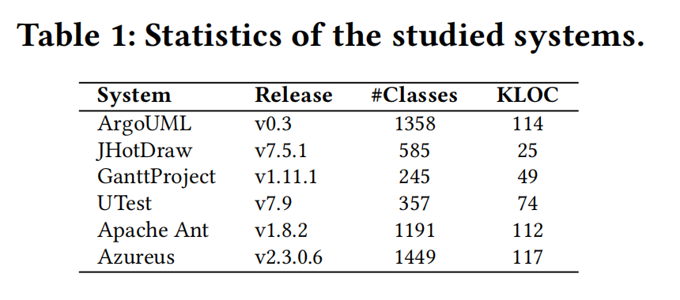
CLUSTERING-BASED INTERACTIVE MULTI-OBJECTIVE SOFTWARE REFACTORING
Dataset:
5 open source projects
1 industrial system
14 active developers
Input:
Source code
Output:
Refactored code

Slide 4
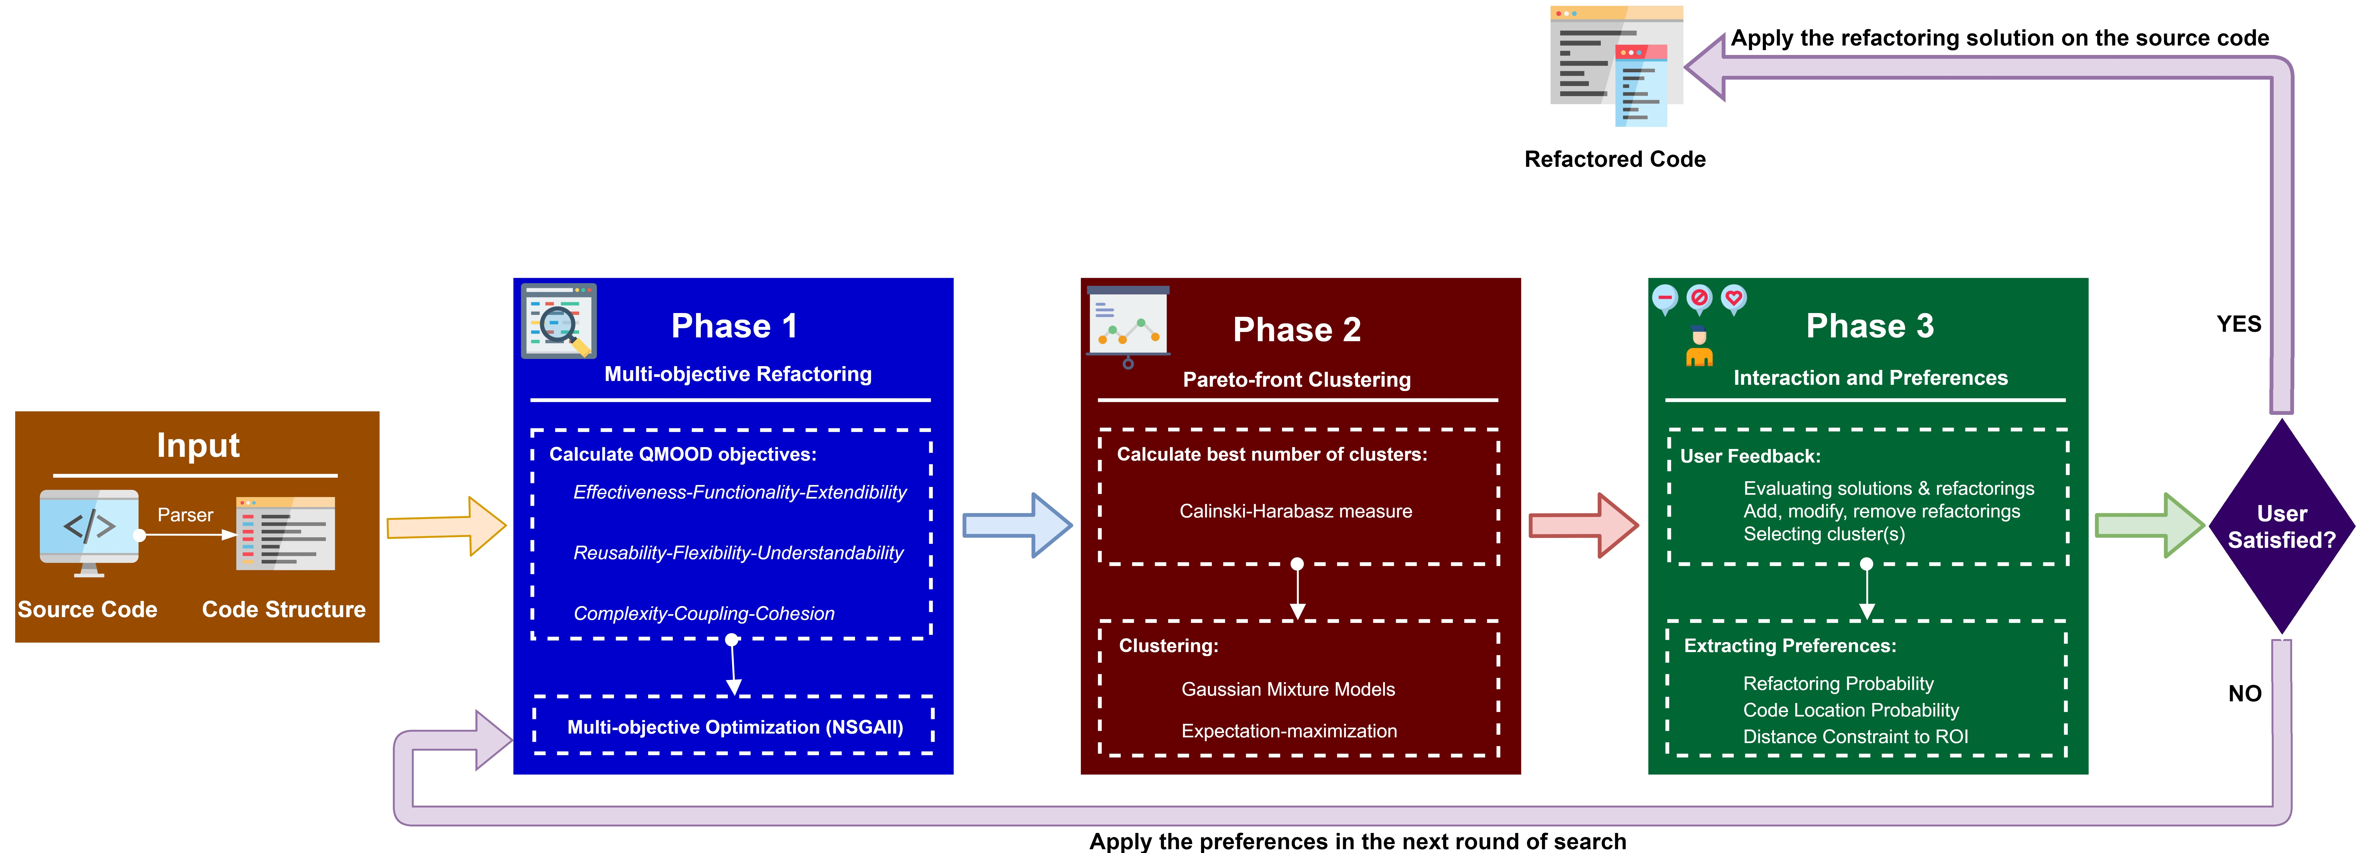
CLUSTERING-BASED INTERACTIVE MULTI-OBJECTIVE SOFTWARE REFACTORING
Phase 1:
Multi-Objective Refactoring(NSGA-II)
Phase 2:
Clustering the Pareto Front of Refactoring Solutions
Phase 3:
Developers Interaction and Preferences Extraction

Slide 5
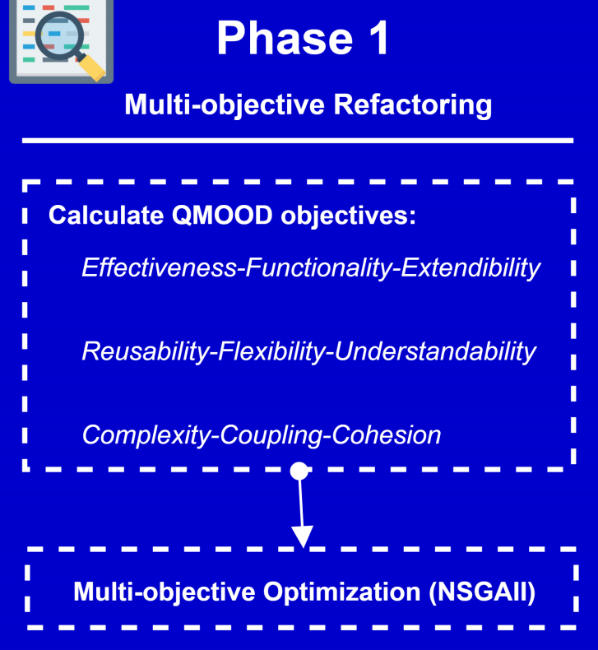
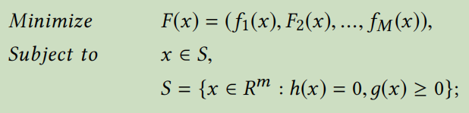
Research Method
Phase 1: Multi-Objective Refactoring(NSGA-II)
Interactive Clustering-based NSGA-II (IC-NSGA-II)
Input :
Population Size (N), Source Code
NSGA-II
Output:
Recommended Pareto-optimal Solutions

Slide 6
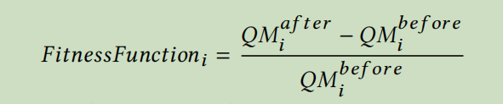
Research Method
Phase 1: Multi-Objective Refactoring(NSGA-II)
Interactive Clustering-based NSGA-II (IC-NSGA-II)
Input :
Population Size (N), Source Code
NSGA-II
Output:
Recommended Pareto-optimal Solutions

Slide 7
CLUSTERING-BASED INTERACTIVE MULTI-OBJECTIVE SOFTWARE REFACTORING
Refactoring types
Refactoring Solution Representation
Move Method,
Move Field,
Extract Class,
Encapsulate Field,
Pull Up Field,
Pull Up Method,
Push Down Field,
Push Down Method,
Extract SubClass,
Extract SuperClass.
a vector consists of an ordered sequence of
multiple refactoring operations.
Refactoring operations are created or modified
randomly during the population initialization
or mutation.
using related pre- and post-conditions
Notes:
领域特定语言

Slide 8
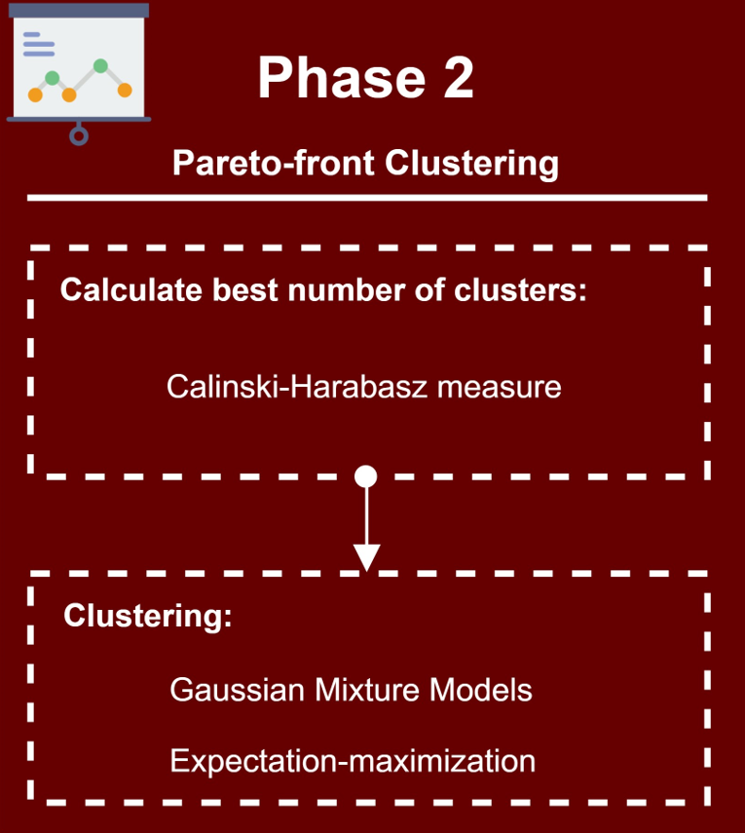
Research Method
Phase 2: Clustering the Pareto Front of Refactoring Solutions
Pareto-front Clustering
Input :
Pareto-front solutions (S)
Calculate best number of clusters-K
GMM Clustering
Find Clusters Representative
Output:
Labeled solutions (LS),
Clusters Representative Solution (CR)

Slide 9
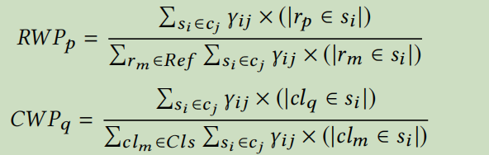
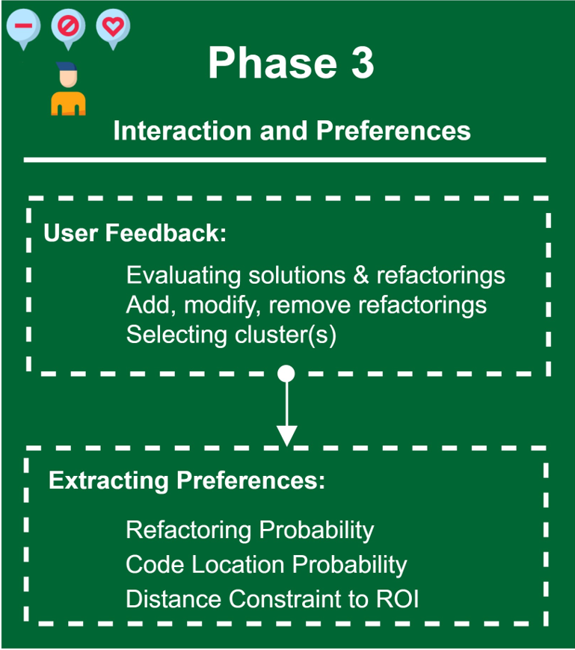
Research Method
Phase 3: Developers Interaction andPreferences Extraction
Interaction and User Preferences
Input :
Labeled solutions (LS)
User Interaction and Feedback
Output:
Preferred Cluster (PC),
Preference Parameters
Notes:
=[
CWP(Classes Weighted Probability,
RWP(Refactorings Weighted Probability),
RS(Reference Solution)]

Slide 10

Research Question
RQ1. Refactorings relevance.
To what extent can our approach make meaningful recommendations compared to existing refactoring techniques?
RQ2. Interactive clustering relevance.
To what extent can our clustering-based approach efficiently reduce the interaction effort?.
RQ3. Impact.
How do programmers evaluate the usefulness of our tool (questionnaire)?

Slide 11
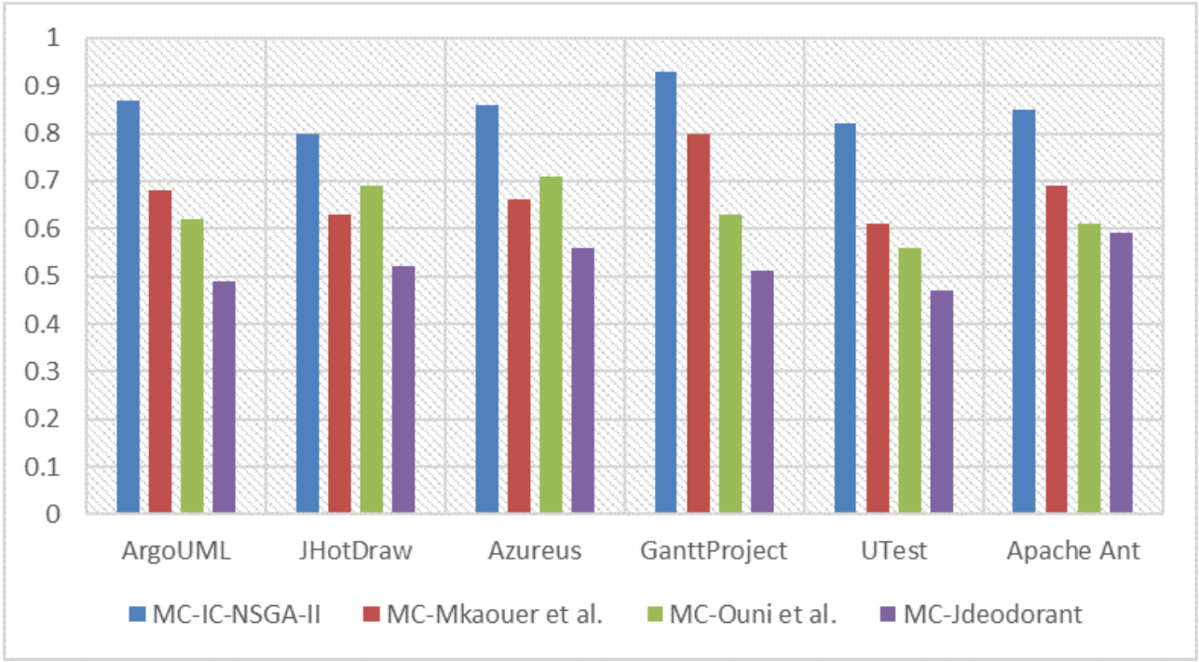
Research Results
Results for RQ1: Refactorings relevance.
14 active programmers to identify and manually evaluate the relevance of the best refactorings sequence that they found using four tools.

Slide 12
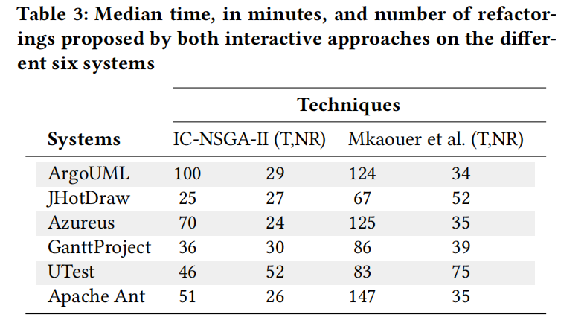
Research Results
Results for RQ2: Interactive clustering relevance.
To what extent can our approach make meaningful recommendations compared to existing refactoring techniques?

Slide 13
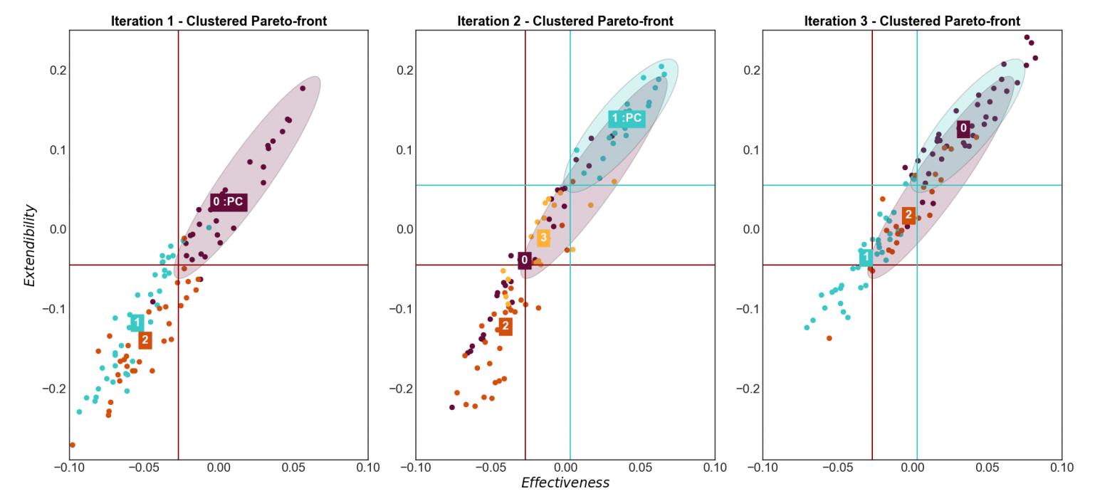
Research Results
Results for RQ2: Interactive clustering relevance.
To what extent can our approach make meaningful recommendations compared to existing refactoring techniques?

Slide 14
Research Results
Results for RQ3: Impact.
To what extent can our approach make meaningful recommendations compared to existing refactoring techniques?
Refactoring with clustering reduces the time of the analysis of the objectives. It keeps the similar type of classes or patterns in the same cluster and dissimilar patterns in another cluster."
All the participants found as well our tool helpful for both floss refactoring, to maintain a good quality design and also for root canal refactoring to fix some quality issues such as code smells.

Slide 15

Future Work
we only focused on the recommendation of refactorings.
We plan to extend the interactive clustering-based approach to others related software maintenance problems .
such as regression testing and bugs localization.
We will also work on making the refactoring recommendations more personalized based on the profile of programmers by learning their preferences.

Slide 16

Guo Yalin
2020.11

